Slide 1

Business Intelligence
UCC March 9th 2011
Jonathan McCarthy

Slide 2
Agenda
What is Business Intelligence (BI)
Core Capabilities of BI
Why do Companies need BI
Benefits of BI
Examples of BI in use
BI Golden Rules

Slide 3
What is Business Intelligence (BI)
Definitions:
Business Intelligence (BI) refers to skills, processes, technologies, applications and practices used to support decision making.
Systems that provide directed background data and reporting tools to support and improve the decision-making process.
A popularized, umbrella term used to describe a set of concepts and methods to improve business decision making by using fact-based support systems. The term is sometimes used interchangeably with briefing books and executive information systems.
Business Intelligence is a broad category of applications and technologies for gathering, storing, analyzing, and providing access to data to help clients make better business decisions.
A system that collects, integrates, analyses and presents business information to support better business decision making.
Business Intelligence is an environment in which business users receive information that is reliable, secure, consistent, understandable, easily manipulated and timely...facilitating more informed decision making

Slide 4
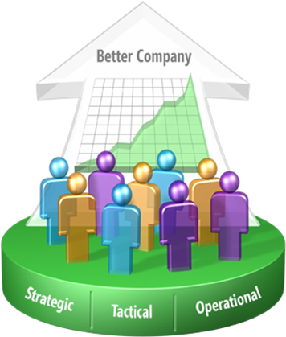


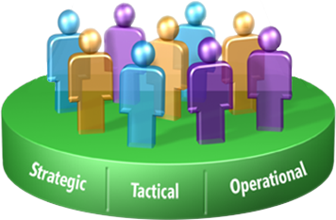
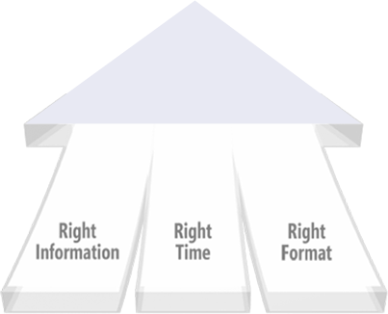
What is BI (continued)
Improving organizations by providing business insights to all employees leading to better, faster, more relevant decisions
© 2008 Accenture. All Rights Reserved.

Slide 5
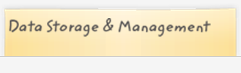
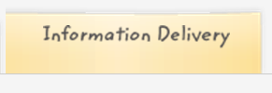


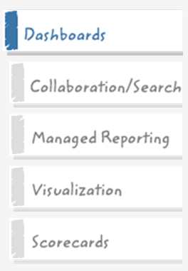
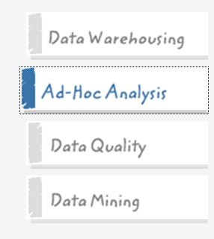
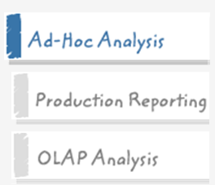


Core Capabilities of BI

Slide 6
Why do companies need BI?
What’s the best that can happen?
What will happen next?
What if these trends continue?
Why is this happening?
Optimization
Predictive Modeling
Forecasting/extrapolation
Statistical analysis
Tactical / Strategic BI
Competitive Advantage
Alerts
Query/drill down
Ad hoc reports
Standard reports
What actions are needed?
Where exactly is the problem?
How many, how often, where?
What happened?
Operational BI
Sophistication of Intelligence
© 2008 Accenture. All Rights Reserved.

Slide 7
Benefits of Business Intelligence
Improve Management Processes
  planning, controlling, measuring and/or changing resulting in increased revenues and reduced costs
Improve Operational Processes
  fraud detection, order processing, purchasing.. resulting in increased revenues and reduced costs
Predict the Future

Slide 8
Examples
- EMC
1998: Revenue $2.5b
1998: HW (90%) + SVCS (10%) + SW (0%)
Strategic BI: predictive modelling => decision made
HW (10%) + SVCS (10%) + SW (80%)
2010: Revenue $16b

Slide 9
EMC Quarter Activity
Typical Activity by Week ($M) (Storage Products)
700
Factories ship ≈40% of quarterly revenue in last week!
Build to Stock for orders in last two days!
600
500
Factory Shipments
400
$ Millions
300
Bookings
200
100
0
1
2
3
4
5
6
7
8
9
10
11
12
13
Fiscal Week

Slide 10
EMC Order Life Cycle
Suspect
Prospect
Lead
Oppty
Configure
Price
Quote
Order
Produce
Ship
Invoice
Collect
Service
Account Planning
Quota
Channel Integration
Project
Accounting
Commissions
$250B
Notes:
Dell – 4 Hours Lean Manufacturing

Slide 11
Examples
- Walmart
Average daily sales of American Flags = 6,000
September 11th 2001
All competitors ran out of flags
Nearest rival sold 20,000
Walmart sold 116,000 flags on that day alone

Slide 12
Further examples
Call centres
  e.g. Top Agent awarded bonus -> competition leading to performance improvements
Banks
  jettison walk in customers to encourage online only
Criminal Minds
  Information gathered on previous actions of serial killers allows the team to predict the actions of future serial killers
Revenue Service
  who has the yacht but cannot afford it
Plagiarism detection in colleges
Customer Loyalty Programs
Twitter analysis for public mood
Dell
Healthcare
  predicting infection in rural parts of third world

Slide 13
BI Golden Rules
Data Quality & Accuracy
Data Consistency
Data Timeliness
“Get the right information to the right people at the right time”

Slide 14
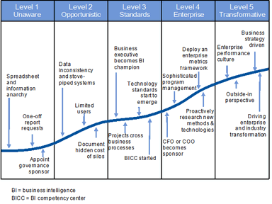
Gartner BI Maturity Model

Slide 15
Why do companies need BI?
What’s the best that can happen?
What will happen next?
What if these trends continue?
Why is this happening?
Optimization
Predictive Modeling
Forecasting/extrapolation
Statistical analysis
ANALYTICS
(Tactical & Strategic)
Competitive Advantage
Alerts
Query/drill down
Ad hoc reports
Standard reports
What actions are needed?
Where exactly is the problem?
How many, how often, where?
What happened?
DATA
ACCESS & REPORTING
(Operational)
Sophistication of Intelligence
© 2008 Accenture. All Rights Reserved.

